Slide 1
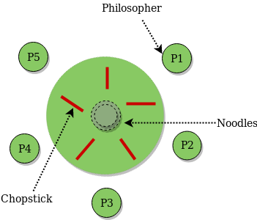
Dining Philosophers
• Five philosophers spend their lives thinking and eating rice.
• There are only 5 chopstick on the table, one between every two philosophers.
• In order to eat, a philosopher needs to get hold of the two chopsticks that are closest to her.
• A philosopher cannot pick up a chopstick that is already taken by a neighbor.

Slide 2
Mutexes
Mutexes are used to prevent data inconsistencies due to race conditions. A race condition often occurs when two or more threads need to perform operations on the same memory area, but the results of computations depends on the order in which these operations are performed. Mutexes are used for serializing shared resources.

Slide 3
Semaphore

Slide 4
Monitors

Slide 5
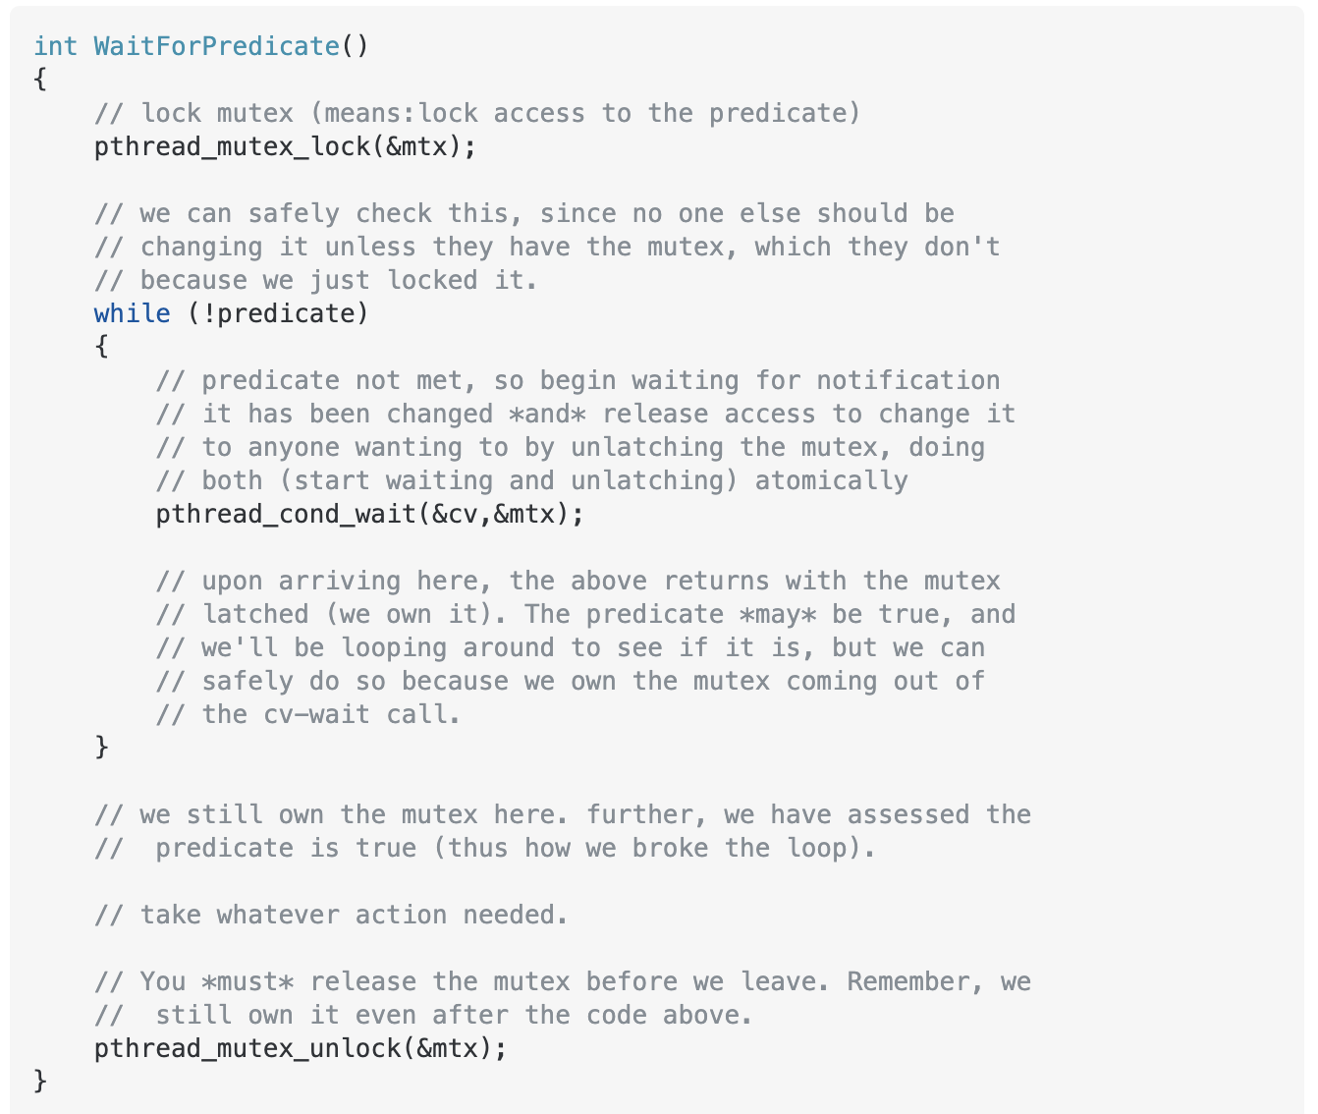
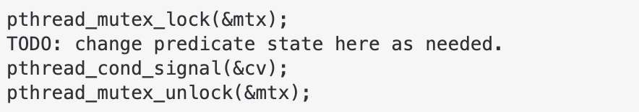
Monitors
T1
T2

Slide 6
#include <semaphore.h>
sem_t sem;
sem_init(&sem, 0, count);
sem_wait(&sem);
sem_post(&sem);

Slide 7
pthread_mutex_t mutex;
pthread_mutex_lock(&mutex);
pthread_mutex_unlock(&mutex);
pthread_cond_t wait_for_cons;
pthread_cond_wait(&wait_for_cons, &mutex);
pthread_cond_signal(&wait_for_prod);

